Slide 1
Canterbury Tales
Yasser Ali
Layla Al Blooshi
Abdulla Fared
Saeed AlAbbasi

Slide 2
Introduction
“Your overriding goal is to go where no one
else has ever gone before.”
On positive side:
- We can be creatively rational as well as open minded and just.
On negative side:
- We might be an impractical and indecisive procrastinator. Interestingly, your preference is just as applicable in today's corporate kingdoms.

Slide 3
Doctor
Direct characterization and Indirect characterization
  Heal
  Most of the time he is found wearing Blood-red garments or gray garments.
  skinny or slim body.
  He doesn’t like to eat much
  Likes to discover
  Kind.
  Not much of a religious person
  Greed.
  Gracious person
  Astronomy.

Slide 4
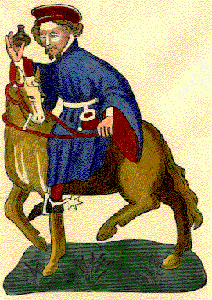
Doctor
Indirect characterization:
-Likes to discover
- Kind.
- Not much of a religious person
- Greed.
- Gracious person
-He is a physician
- Astronomy.

Slide 5
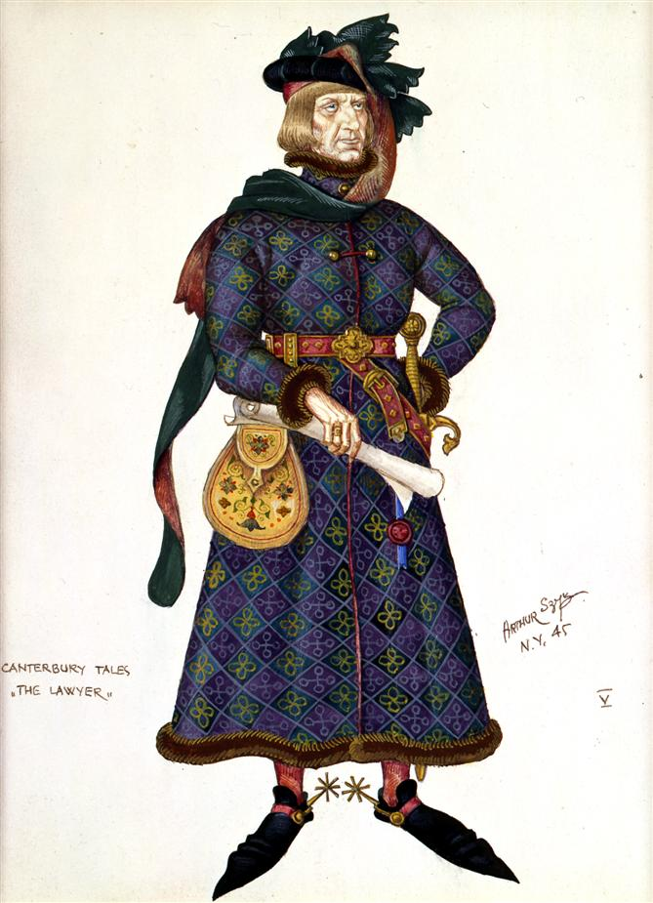
Host
Direct characterization and indirect:
  leaded a group
  Expensive clothing.
  Direct in his speeches
  Bold
  Wise man

Slide 6
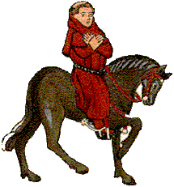
Parson
Direct and indirect characterization
  Churchman
  Preacher
  Diligent
  Patient
  Holy-minded
  poor

Slide 7
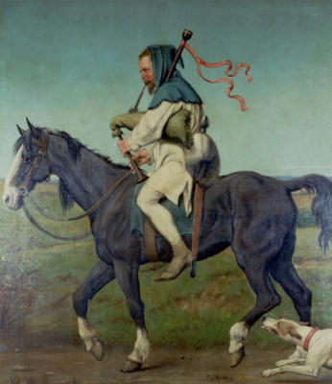
Miller
Direct and indirect characterization
  Strong
  He has beard
  Short shouldered
  Wide nostrils
  Sword and buckler on his side
  Blue and white coat
  Story teller

Slide 8
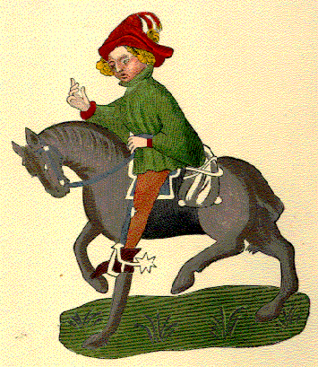
Maniple
Direct and indirect characterization
  Lack of education
  Inner temple keep
  However, he is smarter than 30 lawyer men he feeds.

Slide 9
Future job
The Doctor would be just like any other doctor. He will have the same job.
The wife of Bath will be highly respected by everyone. She will have a high position today in the society.
Miller will have a show wrestler, who entertain people.
The manciple will have a low income job. However, if he tries to improve himself he will get a better job because he is smart.

Slide 10
Summary
The charters was really interesting. They had different personalities and likings. Most of them will have a future job. The doctor is the only one who will have the same job over the years.

Slide 11
Conclusion
All the characters is nice and perfect. They are wise people who think before they do anything. They like to discover.

